Slide 1
Welcome to Mrs. Eick’s
2nd Grade
Back to School Night

Slide 2
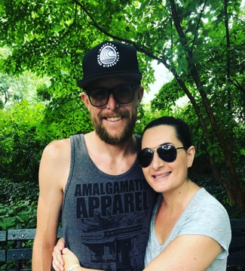
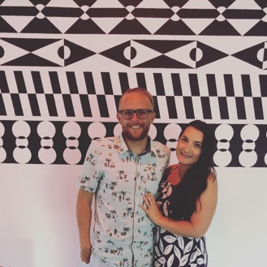
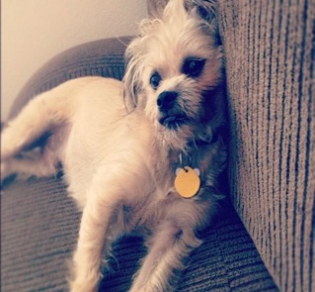
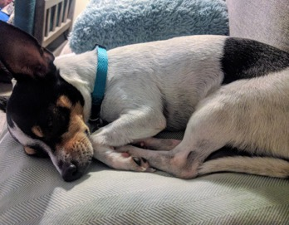
About Mrs. Eick
Grew up in the Bay Area and San Diego
Family of teachers
Master’s degree in Education with a Specialization in Reading
6th year at ECC
Lifelong learner!

Slide 3
Classroom Goals
Create a safe and nurturing classroom environment
Celebrate accomplishments, regardless of size
Provide instruction at an appropriate level so that all students make measurable academic gains

Slide 4
Daily Schedule
8:00 Morning Meeting/ Silent Reading
8:15 Language Arts
10:00 Recess and Snack (Please send a healthy snack daily!)
10:25 Read Aloud
10:30 Math
11:50 Lunch
12:30 Writing, P.E., Rotations, Art Ed.
On Wednesday’s, we have Wheel
2:20 Dismissal

Slide 5
Math Curriculum
Operations and Algebraic Thinking
Problems involving addition and subtraction
Add and subtract within 20 (mental math)
Foundations of multiplication
Numbers and Operations in Base Ten
Understand place value
Use place value to add and subtract
Measurement and Data
Measure and estimate lengths in standard units
Work with time and money
Represent and interpret data
Geometry
Reason with shapes and their attributes
www.Corestandards.org

Slide 6
Math Instruction
Digital Curriculum:
i-Ready
ST Math
IXL
XtraMath
i-Ready Math Program
Whole class math lessons
Small group lessons
Math games
Opportunities for further analysis through math journals, hands-on activities, and number talks
To qualify for enrichment based work, all students need to have scored above 90% on both Common Core based assessments. These were administered the first week of school.

Slide 7
English Language Arts Curriculum
Reading: Literature
Reading comprehension strategies, story structure, compare and contrast
Reading: Informational Text
Identify the main idea in a text; know and use text features
Reading: Foundational Skills
Read with sufficient accuracy and fluency to support comprehension
Writing
Genres- Narrative, Opinion, Informational
Grammar
Phonics
Spelling
Pretests each Monday, Posttests on Friday. Alternate Lists given to kids who only miss 0 or 1 word on the pretest.

Slide 8
English Language Arts Instruction
Extension
opportunities:
Leveled guided
reading groups
Students will
analyze complex
text and
become more
familiar with the
academic language
presented.
*Junior Great Books,
College of William and
Mary
National Geographic Reach for Reading curriculum
Small group instruction/ Centers
Writing: Incorporating San Diego Writing Project, and journal writing skills
Library
Class library- leveled and students will know which AR books to read
Power Reading Books: Leveled books available at the Media Center

Slide 9
Homework
Homework is given on Monday and due on Friday morning.
Will be emailed out every Monday morning
Return packets in daily folder on Friday
Online components may include: Xtra Math, ST Math, Spelling City
The homework is consistent throughout the grade level
Parents are encouraged to check work
Enrichment opportunities on class website
Please let me know via e-mail of any difficulties you or your child may be having!

Slide 10
Behavior Management
Positive reinforcements include:
Verbal praise and recognition
Compliment Cards will be earned when I see a certain behavior
Team/table points
Whole class rewards: Students will be working towards a certain reward
Behavior Folder- sent home every Friday. Please review with your child, sign, and return on Monday.

Slide 11
Behavior Expectations
Listen when someone is talking
Follow directions the first time
Treat everyone with kindness and respect
Take care of our school and classroom
Work and play safely and quietly

Slide 12
Communication
Newsletter via e mail every Monday with reminders for the following week and to keep you updated with the day to day activities.
The homework for the week will be attached.
Email is the best way to contact me.
Please bookmark my website as it will be very helpful throughout the year. Ceick.weebly.com
Class Dojo
Will be used to post pictures of students throughout our day.
Handout to sign up and download the app.

Slide 13
Other Items of Interest
Field Trips: We typically only take 3-4, with most of them being toward the end of the year.
Birthdays:
Non-food items
Alternate treats include: stickers, pencils, erasers, etc.…
Read your child’s favorite book to the class! I can work with your schedule.
Donations:
Scholastic News, $6.33 per student (see handout)
Optional: Wish list items ☺

Slide 14
Volunteers
Room Parent(s)
Art Education
Garden Science
Language Arts/Math Centers
Field Trip coordinator
Yearbook page coordinator (photos)
Mrs. Eick’s Helper (at home)
Copy Parent
Guest Readers

Slide 15
Thank You for Coming!
Please Fill out the Following Forms:
Volunteer Information
Scholastic News (can send in with donation
later)
Note to your child (if you have time ☺)

